Slide 1
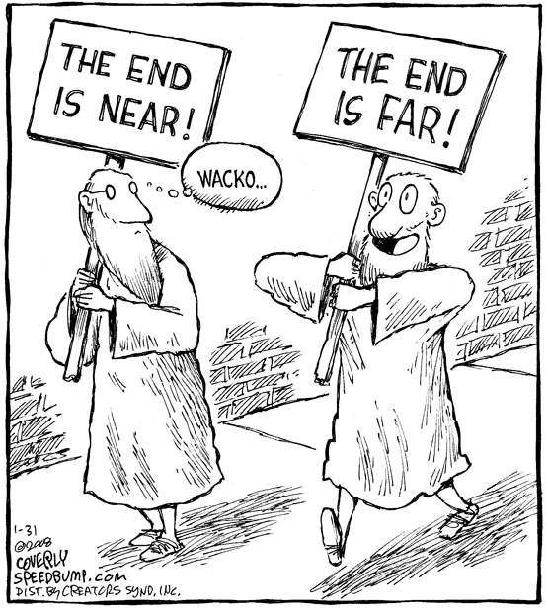
Week 53
It’s the end of the world as we know it…
…and I feel fine.

Slide 2
1 Peter (1631)
“Though you have not seen him, you love him; and even though you do not see him now, you believe in him and are filled with an inexpressible and glorious joy, for you are receiving the goal of your faith, the salvation of your souls.” (1632)

Slide 3
1 Peter
Christ, the perfect sacrifice (1632)
Holiness because of said sacrifice
Submission in Suffering
What do you know about Peter that helps you understand 1 and 2 Peter?

Slide 4
How should we, individually, respond to persecution?
Passivity Pacifism
No response; silence (Jesus?)
Activism
Resist subversively (Rahab?)
Accept punishment gladly
Resist violently – fighting against “evil” (Elijah?)
Middle Ground?
Speak in self-defense (Stephen?)
File suit back? Appeal? (Paul?)
Affect community change to result?

Slide 5
Persecution Givens:
Don’t be surprised.
Don’t let it be because you’re an idiot. Or sinful.
Don’t quit.
Don’t be a martyr…
Do trust God.

Slide 6
2 Peter: Are we there yet??
With?
Not ineffective
Not unproductive
Without?
Nearsighted, blind, forgotten forgiveness!
The Christian Graces (1637)
Faith
Goodness
Knowledge
Self-Control
Perseverance
Godliness
Brotherly Kindness
Love
Therefore, be all the more eager to make your calling and election sure. For if you do these things, you will never fall, and you will receive a rich welcome into the eternal kingdom of our Lord and Savior Jesus Christ.

Slide 7
The End is Coming. Really.
We’ve been singing “Jesus is Coming Soon” since 1942: before the end of World War 2.
We’ve sung “Soon and Very Soon” for almost a decade longer than I’ve been alive.
We’ve read “Yes, I am coming soon” from Revelation 22:20 at least since AD 90.
How much longer? Maranatha! (1 Cor 16:22)

Slide 8
Revelation
Matthew’s Principles:
Revelation = Apocalypse = Unveiling
Occam’s Razor
Understand what we can.
Just stinkin’ read it!
Technically, the book’s name is Revelation. Please don’t call it RevelationS—because it annoys me.

Slide 9
Revelation
Written either 69-70AD or 90-94AD by John the Apostle while exiled in Patmos.
Designed to be relevant to the original hearers…like the rest of scripture!

Slide 10
Extremes
Obsessive
Dismissive
Left Behind
Is this the end? Is this? How bout this?
Ingersoll: “the insanest of all books.”
Jefferson: totally omitted “the ravings of a maniac”
Luther: “an offensive piece of work”
Calvin: grave doubts about value
God’s patience is for man’s good!

Slide 11
Hebrews
Author: Paul, (Luke Translated or Barnabas wrote), Apollos, Philip, Priscilla and Aquila, James Hinkle…?
There’s something better (more, greater = 25x)
Encouragement: there’s something that is really worth hanging on to! Don’t quit!

Slide 12
1-3 John: Love and Light and Life
Love God.
Love your brother, or you don’t love God.
If you love the world, you don’t love God.
If you love God, you don’t love sin.
If you love sin, you don’t love God.
Any questions?

Slide 13
Revelation
“Blessed is the one who reads aloud the words of this prophecy, and blessed are those who hear, and who keep what is written in it, for the time is near.” (Rev. 1:3 ESV)

Slide 14
Seven Benedictions
Blessed is the one who reads aloud, hears, and keeps (1:3)
Blessed are the dead who die in the Lord (14:13)
Blessed is the one who stays awake, ready (16:15)
Blessed are those invited to the Lamb’s marriage supper (19:9)
Blessed and holy is the one who shares in the 1st resurrection (20:6)
Blessed is the one who keeps the words of this prophecy (22:7)
Blessed are those who was their robes (22:14)

Slide 16
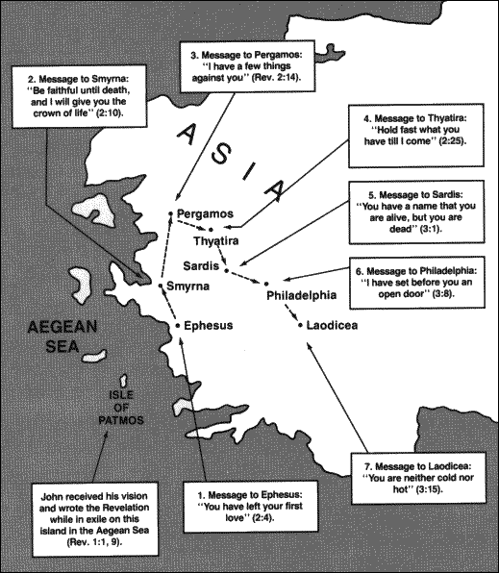

Slide 17
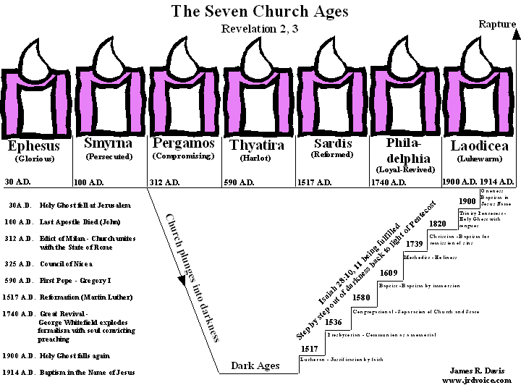
Matthew disagrees with this slide!

Slide 18
Four Approaches to Revelation
Summary of Four Views on Revelation
Thomas Nelson Publishers, Nelson's Complete Book of Bible Maps & Charts : Old and New Testaments., Rev. and updated ed. (Nashville, Tenn.: Thomas Nelson, 1996).
Interpretive Approach | Basic Thesis
Preterist | All the events of Revelation were fulfilled during the period of the Roman Empire.
Historical | Revelation is a panorama of church history from the apostolic era until the consummation
Idealist | Revelation is not a representation of actual events, but is rather a symbolic depiction of the spiritual warfare between good and evil.
Futurist | Beginning with ch. 4, Revelation describes the future events accompanying the end of the age.

Slide 19
Millennialism?
The “thousand year reign” referred to in Revelation 20:1-6
Premillennialism
Postmillennialism
Amillennialism
I’m-making-up-new-words-millennialism-oscity-ness-ly

Slide 20
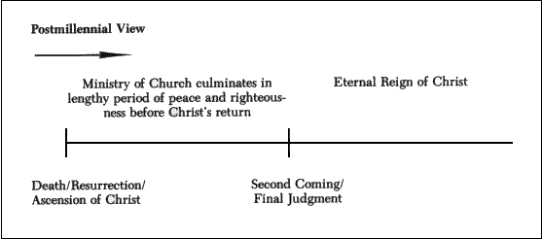
Postmillenialism
The world is getting better, for a literal or figurative thousand year reign before Christ returns.

Slide 21
Premillennialism
Most common (still not my belief), but with many variants: (pre-tribulational and post-tribulational views)
Church will be raptured prior to great year tribulation, then 1000-year earthly reign in Jerusalem, followed by futile revolt, then final judgment and eternal reign.
“Futurist” reading of Revelation
More exciting doctrine. ;-)

Slide 22
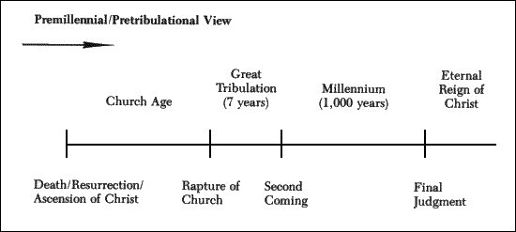
Premillennialism

Slide 23
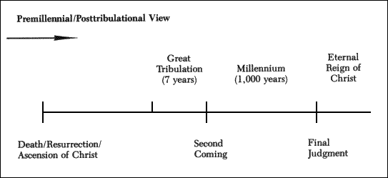
Premillennialism

Slide 24
The Rapture
When we’ll be called up to Christ…meet him in the air, etc etc.
Yes, we believe in it.
Rapio = Seized (1 Thess. 4:13-18, etc.)
The question is it’s timing.
We will all be caught up together, I believe.

Slide 25
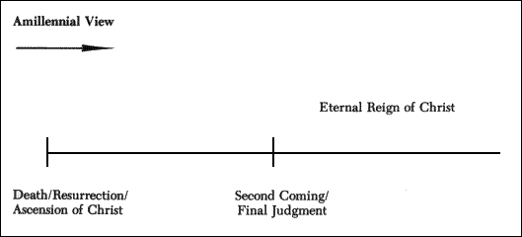
Amillennialism
God reigns through his church already (Acts 2:33-36) and Israel and the Church are already united in that kingdom. The reign is figurative, and is now. (Idealist, preterist, and historicist)

